Slide 1
MyFootballClub Training
October/November 2011

Slide 2
Overview
1 – The MyFootballClub Project
2 – Getting Access
3 – Season Setup
4 – Registrations
5 – Registration Management

Slide 3
The MyFootballClub Project
MyFootballClub is a project that aims to:
Identify and recognise all individuals and organisations involved in football (player, referee, volunteer, club, etc), their multiple relationships within the sport, their interests and needs.
Make volunteers’ lives easier by delivering tools that are easy to use and provide the support they need.
Lower overall administration time and cost for managing football by adopting a shared system for all.
Assist in development planning e.g. participation and retention.

Slide 4
MyFootballClub Portal
An Online Portal for Players, Clubs and Associations.
An information resource for clubs on managing their club including volunteers, facilities, inclusive football, funding and other resources.
A Registration tool
A Competition Management tool
A portal for future initiatives and resources
A player resource, Club Finder tool and portal to Football Family ticketing.

Slide 5
Myths About MyFootballClub
Clubs do NOT lose control of who registers with their club. Clubs and Associations decide which player registrations are accepted.
The system will not alienate your players. The registration system is a tool to assist with registering players. It is not meant to replace your registration days or change the way you interact with your members.
FFA will NOT sell or pass on any player records to third parties, sponsors or others. All participants have the option to opt-out of receiving email communications.

Slide 6
Benefits of MyFootballClub
Club Benefits:
Eliminates the need for paper forms.
Takes burden off club volunteers by allowing individuals to enter their details online and removing the need to fill out forms.
The system is free of charge - Saves you from buying and maintaining your own system.
Reduce volunteers’ administration time, resources and effort .
Ability for clubs to add “Additional Questions” and their own “Terms and Conditions”.
Online system available to you 24x7, anywhere in the world.
Provide instant reporting and reconciliation for all levels of administration.
Players can pay online, clubs receive money sooner. Sell Add-on items, such as uniforms, to players at point of registration

Slide 7
Registration Tool
Club Registration Cycle
Club Registrars request Access to MFC.
Association approves club registrar access.
Club completes season setup – Ages Groups, Fees/Packages (optional: Terms & Conditions, Additional Questions, Add-Ons).
Club Communicates Registration process to Players (letters, emails, website).
Registrations are transferred to Competition Management tool.
Club/Association allocates players and teams in Competition Management tool.
Self Registration (no forms)
Players Register online using Self Registration
Player can Pay Online
Club accepts Registration

Slide 8
Overview
1 – The MyFootballClub Project
2 – Getting Access
3 – Season Setup
4 – Registrations
5 – Registration Management

Slide 9
Getting Access
Club Registrar Access
Member Federation sends out communication to their associations and clubs regarding process and timings. This will include:
the Online User Access form
The Online Payment Gateway request form
Club registrars complete the online form to request access as a Club registrar. (FFA Number is required on the User Access Form)
Club registrars who have an FFA number as a player. Find their FFA number and retrieve password.
Club Registrars who don’t have an FFA number- Need to Create an account through MFC to receive FFA number and password.
All requests are approved and activated by the Member Federation.
* Access is setup per individual. Each individual should request their own access.

Slide 10
Online Payments
Online Payments is Optional.
Online payments allows the club to collect registration fees via a credit card (Visa or Mastercard) payment when the player registers online.
Clubs need to request online payment to be enabled.
There is a yearly subscription fee of $108.90 per club to use online payments.
Each transaction incurs a 2% credit card merchant fee.
Payment is deposited into clubs bank account.

Slide 11
Online Payments
Activating Online Payments
Clubs must complete FFA’s online payment request form. One individual per club will be allowed access to the payment gateway, which should ideally be the club treasurer.
Club calls the MFC Support Centre to pay the $109.80 subscription fee.
Once form is submitted and fee has been paid, FFA will enable online payments for your club and email the details and receipt to the club.
The email will include your username and password to the payment gateway. This is where you can review the online payments and export detailed information of all transactions.
Club needs to go into Our Details and make sure the Payment Gateway option is enabled in their club (refer to Our Details).

Slide 12
Overview
1 – The MyFootballClub Project
2 – Getting Access
3 – Season Setup
4 – Registrations
5 – Registration Management

Slide 13
Self Registrations Process
Self Registration Process for Clubs
1. SET UP: Club sets up registration fees
2. ONLINE REGISTRATION: Player registers online
3. PAYMENT: Player pays online – or – Club marks player as paid offline
4. APPROVING REGISTRATIONS: Club accepts or rejects the registration
REGISTRATION COMPLETE

Slide 14
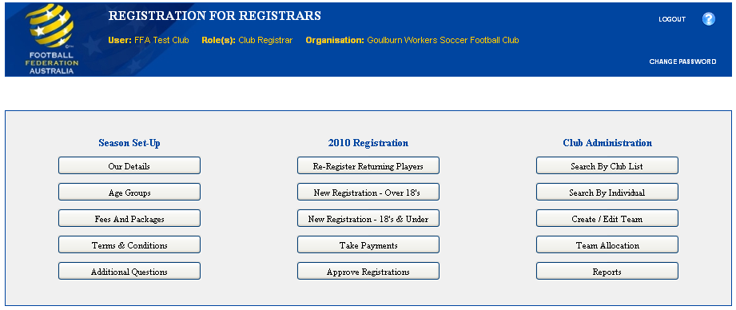
Club Admin Access
1. SET UP:

Slide 15
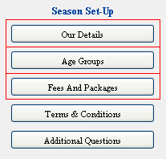
Season Setup
Mandatory Setup
Our Details
Age Groups
Club Fees
Registration Packages (including FFA,
State, Association Fees, etc)
Optional Setup
Terms & Conditions
Additional Questions

Slide 16
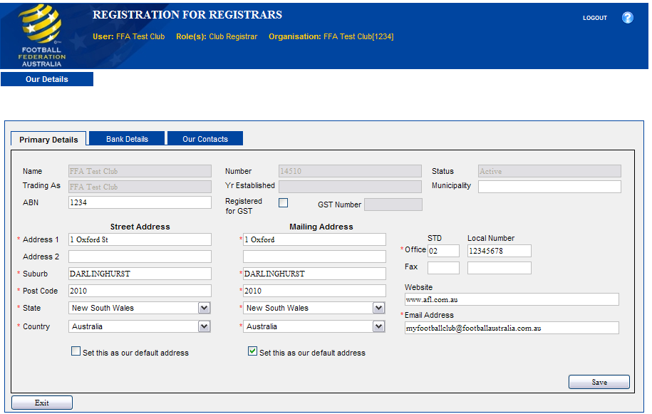
Our Details

Slide 17
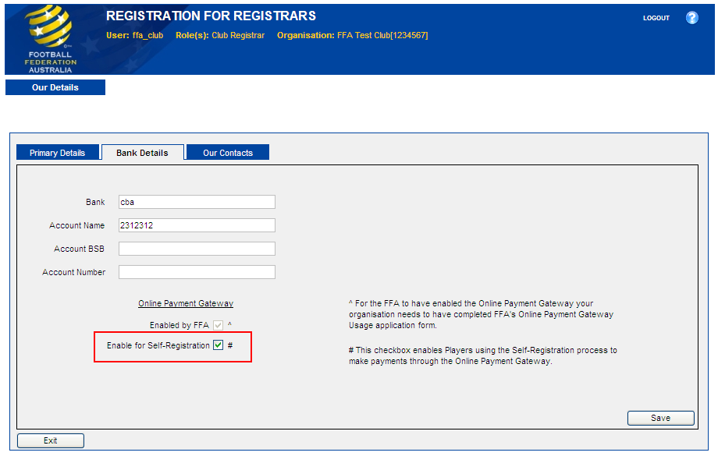
Our Details

Slide 18
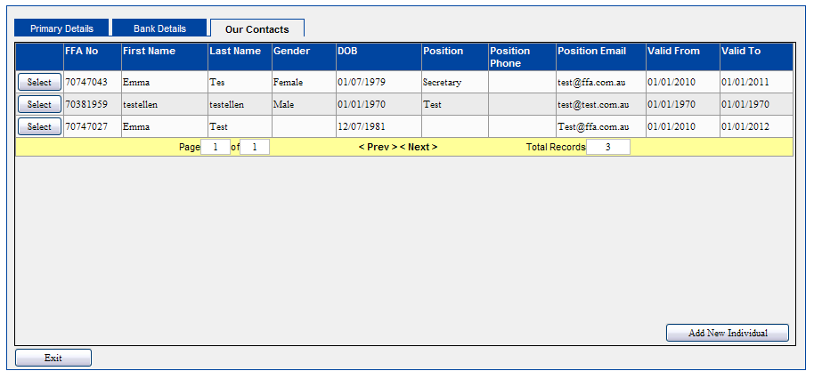
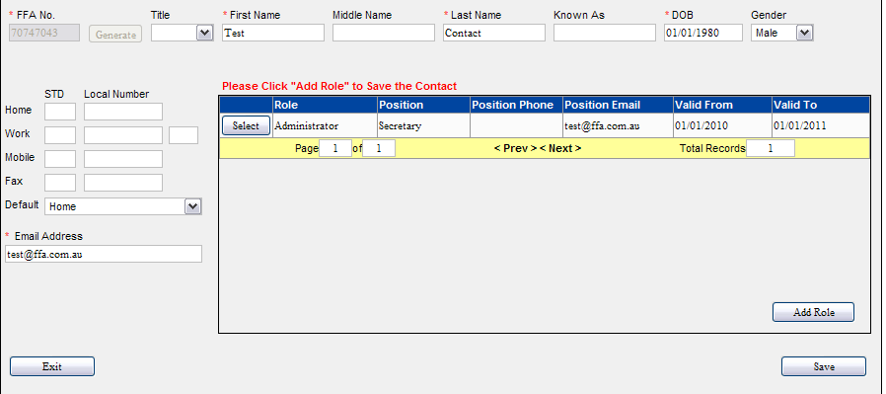
Our Contacts
This section is for clubs to add their primary contacts such as President, Secretary and Treasurer.
Steps to remember when creating a contact:
Search for Contact
Add details
Add Role
Save

Slide 19
Registration Packages
1 Age Groups
As part of setting up registration fees, you will need to decide which fees apply to which age groups. At least one Age Group must be set up for your fees in the system. If the registration fees are the same for all age groups, then only one age group will be required to be set up. It fees vary, then additional age groups will need to be set upe.
We advise you to consider the Member Federation age groups when undertaking this process. The age groups will then be used to setup the fees and registration packages in the steps highlighted below.
2 Creating Fees
Prior to the Club being able to register players you need to establish what your fees are for the season. You will use the age groups setup above within this process. This should be one fee per age group, which is inclusive of all costs associated with the club (eg. ground hire, training equipment).
3 Creating Packages
These fees will then be packaged together with Association, State and National Registration fees to create a Registration Package.

Slide 20
Registration Packages Setup
Training Video
Select ‘Fees and Packages’
Select ‘Add New’
Choose a fee name, alter filters to customise your fee
Select the appropriate Age Group
Enter your club fee
Enable the fee for Online Self Registration (Optional)
Hit ‘Setup Package’
Select the appropriate FFA, Member Federation and Zone fees
Select ‘Add Selected Fee To Package’ to create your Registration Package

Slide 21
Registration Packages
Tips and Considerations
Care must be taken when setting up the age groups as the player will be registering against these age groups when registering with your club. We would recommend that you create less age groups, which will minimize the chances of the wrong package being chosen.
Use age groups that works for your club’s fee structure, however we would advise you to create less age groups, as this is easier for your club to manage.
Please consider whether you have players that are playing outside of their age group, either playing up or down. Remember that they won’t be able to register outside the age range set-up in the system.
If you set up age groups last year, you can use these to create packages this year in your packages.
It is recommended that you prepare your club fees prior to setting them up on the system to ensure that they are correct.
The fees are to be set up so that they clearly identify the fee for the three areas:
1. Club Fee
2. FFSA Fee
3. FFA Fee
Age groups will restrict which packages and fees players can select when registering but will not restrict you from allocating players to a team outside the player’s age group.
Do not register against the fee to test that it is working prior to ensuring that fee is set up correctly as the fee cannot be changed or deleted after this point. We suggest you can either contact your Member Federation.
Communicate the packages, and in particular, the labels that have been setup to your players as well as other club registrars.

Slide 22
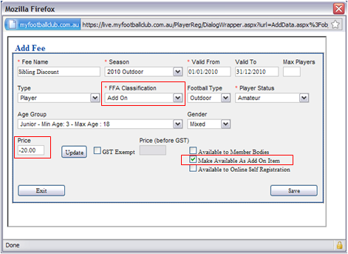
Registration Package Scenarios
Offering discounts for registration
Create an “Add On” fee which can be selected by the player during registration:
Must have Classification set to “Add On”.
Must have the “Make Available As Add On Item” box checked.
Add a negative price to make the item a discount.

Slide 23
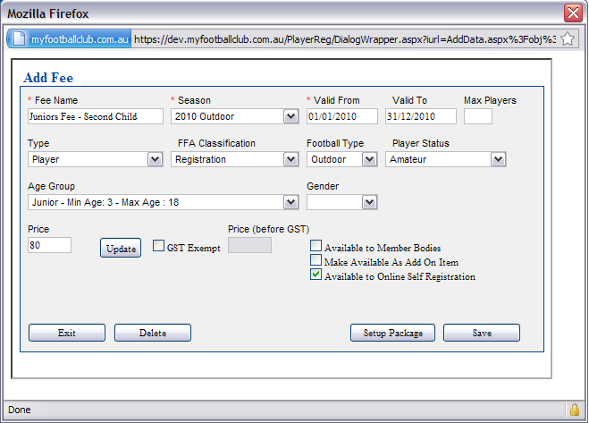
Registration Package Scenarios
Offering a discount for multiple registrations
Create multiple packages to allow for different options
Copy setup for one of your current fees, but change the label and the price.
Players that self register will see both fees.
Important to communicate the message to parents of the club.
You can always reject a registration if person chooses the wrong package.

Slide 24
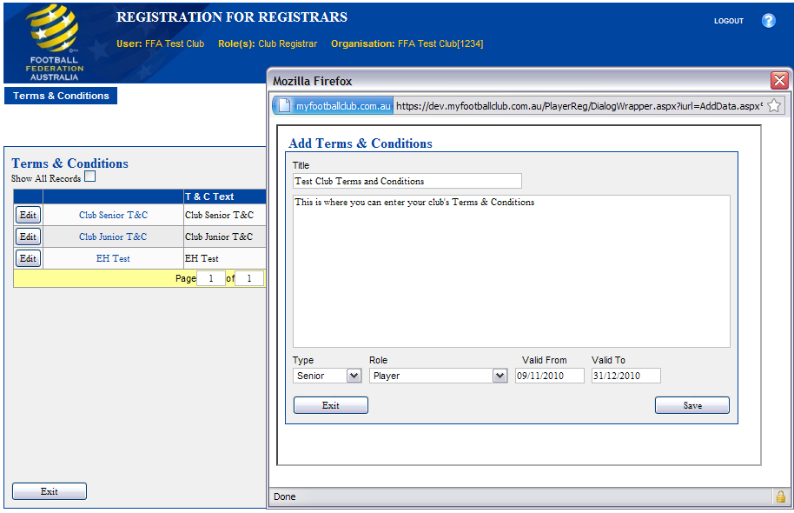
Terms & Conditions Setup

Slide 25
Terms & Conditions Setup

Slide 26
Additional Questions Setup

Slide 27
Overview
1 – The MyFootballClub Project
2 – Getting Access
3 – Season Setup
4 – Registrations
5 – Registration Management

Slide 28
Registrations Overview
Self Registration
Approving Registrations
De-Registrations
Registering Non Player Roles (coach, volunteers)

Slide 29
Self Registrations
2. ONLINE PLAYER REGISTRATION
This is where a player logs into the system, and registers with the club of their choice for the coming season.
A player can only register with a club which has a valid registration package. This is controlled by the club using age groups, start/end dates, gender, football type, season, etc.
When a player self registers they do not need to complete an FFA Player Registration Form.

Slide 30
Self Registration
Training Video
Player goes to www.myfootballclub.com.au
Finds FFA no. and retrieves a password, or creates a new account
Logs in and selects ‘Register Now’
Update personal details
Upload head shot photograph
Type in club name, select type (player) and select package
Acknowledge Terms & Conditions
Select ‘Invoice Me’ or ‘Pay Now’
Answer any additional questions
Registration complete & pending approval by club.
3. PAYMENT (optional)

Slide 31
Self Registrations Scenario
I want my players to self register before the Registration Day (Pre Registration)
Club communicates and instructions to players (Self Registration Template).
Players bring invoice to club on Registration Day
Players can make payment, collect uniforms, etc, at registration day.
OR
Club can record paid players and accept in bulk at the end of the day.
For any players that did not pre-register
Club can take payment and give the player instructions to self register at home

Slide 32
Self Registrations Scenario
I want to host my Registration Day before my players register online (Post Registration)
Send out Registration Day invites to players & community.
Players attend the Registration Day and pay fees, collect uniform etc.
Club then gives each player an instruction sheet (Self Registration Template).
Players go home and do a self registration.
Club logs into Club Admin and accepts registrations.
This process can also be used for clubs who have selection trials and pick their teams before they register the players.

Slide 33
Self Registrations Tips
Provide your players with clear instructions. Use and customise the Self Registration Template to guide them through selecting the right options.
Set up an early bird registration at a reduced rate to encourage players to self register within a particular timeframe.
Clubs can control when and which players can register for their club.
Once a player has self registered – they are pending. The club then accepts or declines the registration.
The player has the opportunity to view and accept the Terms and Conditions by clicking a box – this is accepted as legally binding. Requires NO FORM.
When a player self registers they do not need to complete a form of any kind even if they are new to Football.

Slide 34
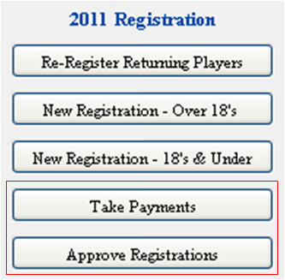
Approving Registrations
4. APPROVING REGISTRATIONS
Accepting a player is a 2 step process:
Taking Payment for the player (Updating Payment Status)
Approving a registration
An important part of Accepting a player is understanding Player Status. A player is not considered registered until their status is ‘Active’

Slide 35
Registrations Status
Pending (Awaiting Payment): The player has registered their interest for your club, but you need to update both payment status and approve the registration.
Pending (Awaiting Approval): The player is recorded as paid, but has not been accepted by the club.
Active: Registered and Accepted by the club
Inactive: Player was previously registered, but the registration is no longer Active.
Declined: Player has been declined by the club

Slide 36
Approving Registrations
Training Video
Club Registrar selects ‘Take Payments’
Searches for individual’s invoice or uses filters for bulk search
Find appropriate invoice(s)
Record payment for individual invoice by hitting ‘Select’, or process multiple unpaid invoices by ‘Bulk Payment’
Choice appears to Approve Registration in the same workflow; or
Select ‘Approve Registrations’
Select appropriate check boxes and hit ‘Approve Registrations’
REGISTRATION COMPLETE

Slide 37
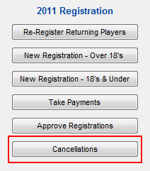
De-Registering a Player (Transfers)
Inevitably, there will be cases where a player will need to cancel their registration with a club for one reason or another.
If the registration status is pending you can simply decline the registration.
If the player has already been made ‘Active’ then the player needs to be de-registered with the first club before they can register with another club.
There are 2 options to cancel a registration:
Offline Cancellation:
Complete the NRR 08 Cancellation of Amateur Registration form signed by player and club.
Submit the form to your Association.
Association will update the player status in MyFootballClub to ‘Cancelled’.
Player is free to register with another club.

Slide 38
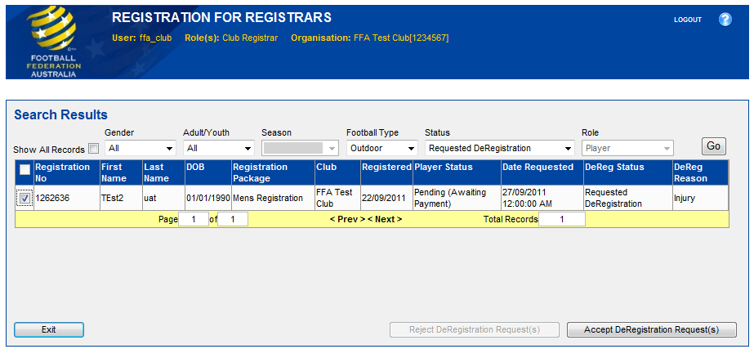
De-Registering a Player (Transfers)
Online Cancellation (no forms)
Player logs in to their account and requests to De-Register.
Request comes through to club to approve De-Registration.
Association can approve or reject the De-Registration.
If approved, the player is then free to register for another club.

Slide 39
Registering Non-Playing Roles
Registering coaches and volunteers
MyFootballClub has the ability for your club to register non-playing roles within the system. This includes coaches and volunteers.
To do this, you must first create the appropriate registration fee. The fee must have the ‘Type’ field set to the appropriate type. ie. Coach or Volunteer.
From here, there are 2 options
Non-players can register the same way as players through self registration;
OR
You can register them through Club Admin using the New Registration workflows.

Slide 40
Overview
1 – The MyFootballClub Project
2 – Getting Access
3 – Season Setup
4 – Registrations
5 – Registration Management

Slide 41
Registrations Management
Updating Player Details
Team Allocations
Reporting

Slide 42
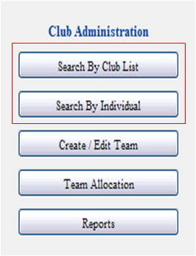
Updating Players Details
At some point throughout the season, it is likely you will need to check or update your players’ details. You can also update the details for you volunteers and coaches in this area.
You have the ability to bring up a list of members through ‘Search by Club List’ or searching for an individual through ‘Search by Individual’

Slide 43
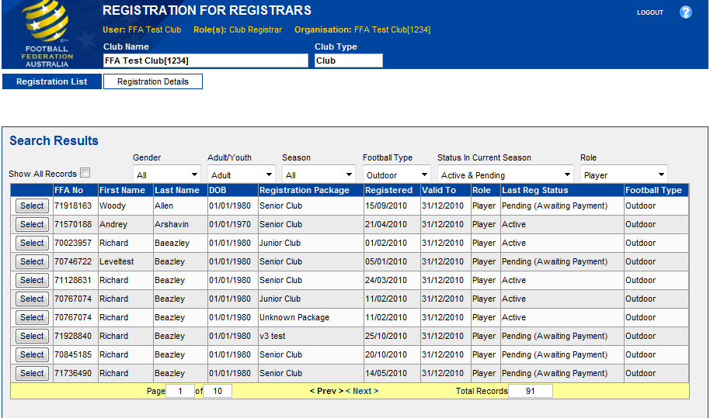
Search by Club List
Use the Filters (Gender, Adult/Youth, Season, Type, Status, Role) to produce a list of your choice

Slide 44
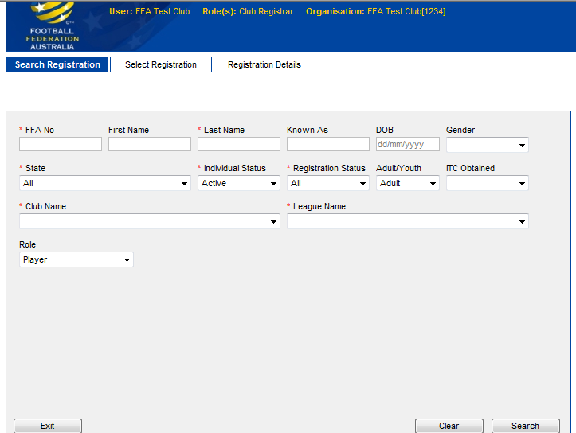
Search by Individual
Enter the player’s details into one, or more, of the fields to find the club member you need.

Slide 45
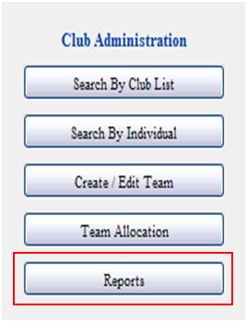
Reports
The reports area provides a number of different reports that allow clubs to find the information they need from registrations.
These reports can be used to help manage administrative duties, such as tracking incomplete registrations, finding contact information, etc.
All the reports can be viewed on the screen, or exported into a number of formats including Excel, PDF, etc
Reports are developed and modified based on club recommendations – we are always happy to take comments/suggestions!

Slide 46
Report Examples
Registered Player (Full Detail) – Shows all registrations with all the data collected as part of the registration. Useful for exporting to Excel. Options available to filter and choose the data required.
Registration Summary Report – Useful high level report that shows statistics and trends of your clubs registrations.
Additional Questions – Provides a list of responses to your club question for each registration.
Parent Details – Provides a list of contact details of players’ parents.
Fee Breakdown – Shows the breakdown of fees for each registration. Useful to work out how much of the fees will be distributed to organisations above clubs.

Slide 47
MyFootballClub Support Structure
MyFootballClub Support Centre
(02) 8020 4199
myfootballclub@footballaustralia.com.au
MyFootballClub website (www.myfootballclub.com.au)
Manuals
Videos

Slide 48
thank you
Please contact Ben Langford for further information: t: +61 2 8020 4114 e: Ben.Langford@footballaustralia.com.au

